Slide 1
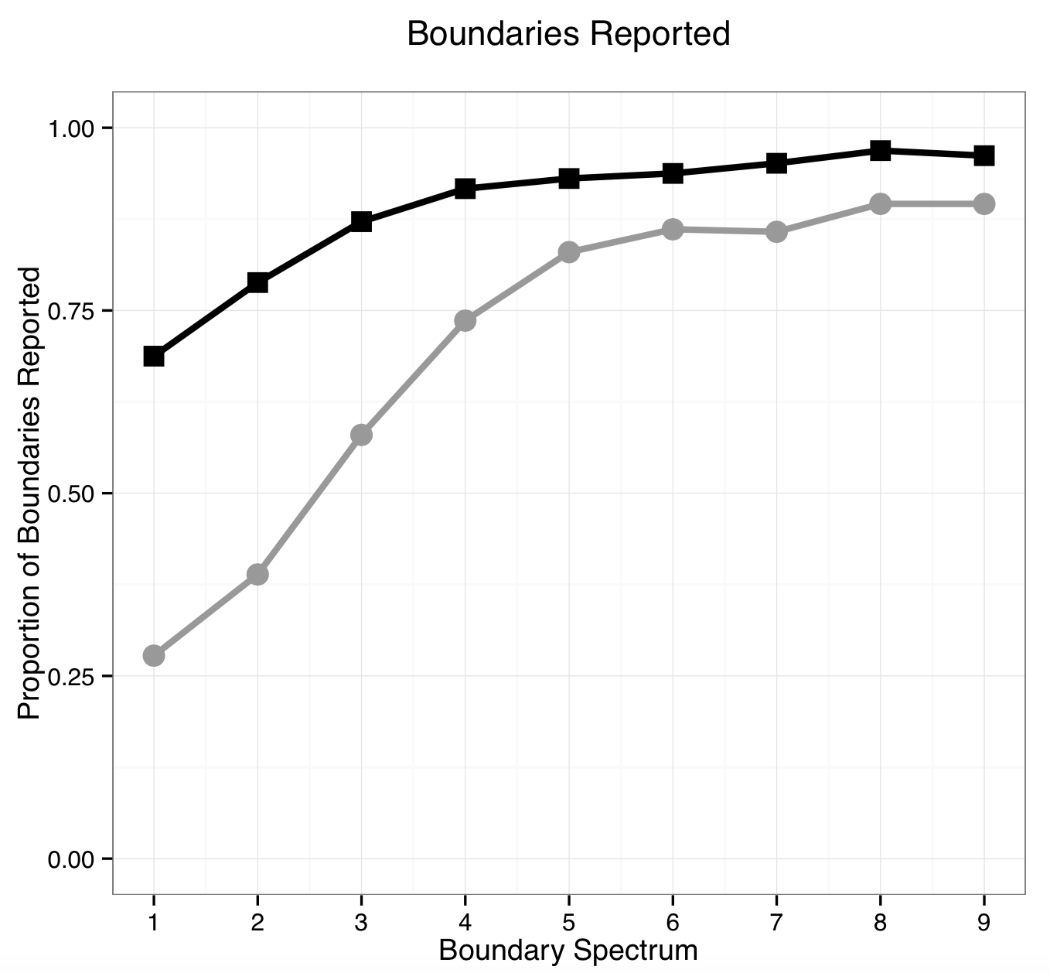
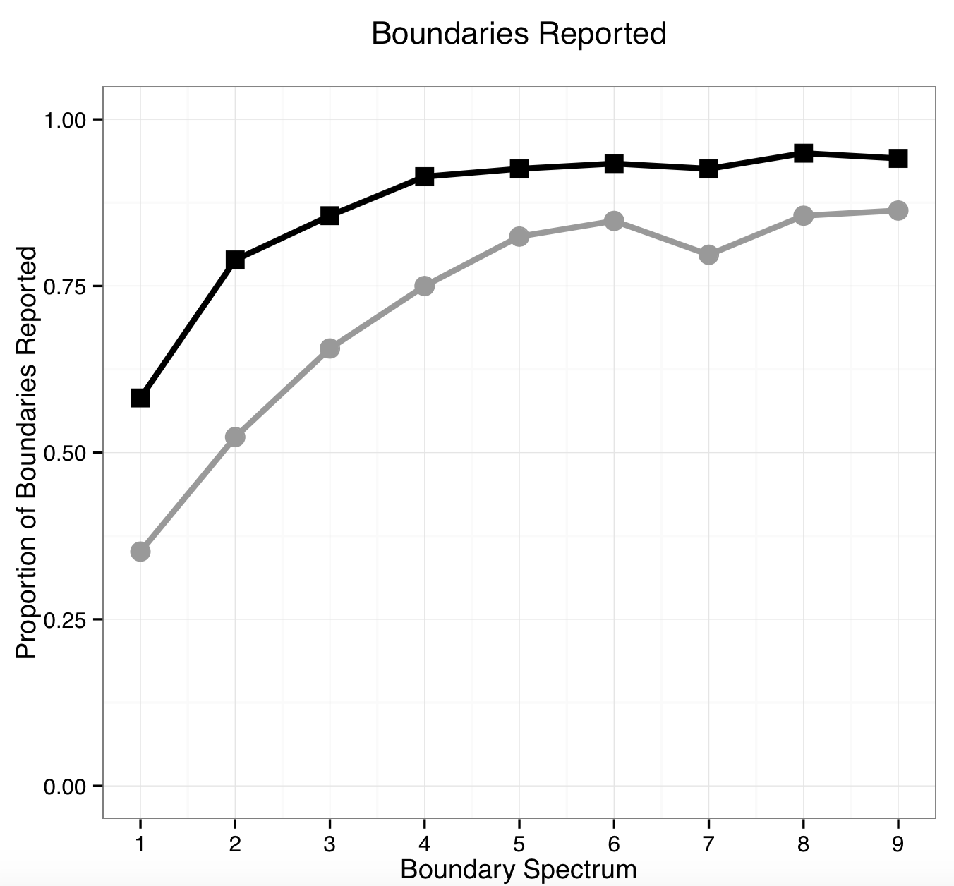

Top-down Processing of Intonational Boundaries
Andrés Buxó-Lugo & Duane Watson Department of Psychology, University of Illinois at Urbana-Champaign
Introduction
The distribution of syntactic boundaries and intonational boundaries are correlated (Cooper & Paccia-Cooper, 1980; Ferreira, 1993; Watson & Gibson, 2004).
Listeners use boundaries to decipher the linguistic structure of a message (e.g. Snedeker & Trueswell, 2003).
However, prosody has its own representation that must be parsed. What types of information affect how prosodic information is structured?
Recent research has shown that syntactic context (not acoustic cues) is the best predictor of whether a boundary is perceived in a speech corpus (Cole, Mo, & Baek, 2010).
We investigate whether expectations about likely locations for boundaries influence listeners’ perception.
Results
Reports at syntactically licensed location in black; reports at syntactically unlicensed location in gray.
Conclusions
Listeners’ perception of intonational boundaries is guided by their expectations about where boundaries should occur.
Whereas boundaries are often thought of as cues that aid syntactic parsing, the data suggest that this relationship is bidirectional.
These results have important implications for human labeling as a tool for coding prosody: when labelers mark a boundary, is the label driven by the acoustic input or is it driven by the labelers’ expectations?
References
Cole, J., Mo, Y., & Baek, S. (2010). The role of syntactic structure in guiding prosody perception with ordinary listeners and everyday speech. Language and Cognitive Processes, 25, 1141-1177.
Cooper, W. E., & Paccia-Cooper, J. (1980). Syntax and speech. Cambridge, MA: Harvard University Press.
Ferreira, F. (1993). Creation of prosody during sentence prosody. Psychological Review, 100, 233-253.
Mo, Y., Cole, J., & Lee, E-K. (2008). Naïve listeners’ prominence and boundary perception. In P. A. Barbosa, S. Madureira, & C. Reis (Eds.), Proceedings of the Fourth International Conference on Speech Prosody (pp. 735-736). Campinas, Brazil, May 6-9, 2008.
Snedeker, J., & Trueswell, J. (2003). Using prosody to avoid ambiguity: Effects of speaker awareness and referential context. Journal of Memory and Language, 48, 103-130.
Watson, D. G., & Gibson, E. (2004). The relationship between intonational phrasing and syntactic structure in language production. Language and Cognitive Processes, 19, 713-755.
Hypotheses
Hypothesis 1
Perception of boundaries is based on acoustic cues alone.
Hypothesis 2
Perception of boundaries is influenced by sentences’ syntactic structure.
Experiment 2
Maybe our instructions biased listeners?
Subjects in Experiment 1 only heard examples of boundaries at syntactically licensed locations during the instruction phase.
Ran experiment again, this time with examples of boundaries in syntactically licensed and syntactically unlicensed locations during the instruction phase.
Participants
16 monolingual American English speakers from Amazon Mechanical Turk.
Experiment 1
Participants
18 monolingual American English speakers from Amazon Mechanical Turk.
Conditions
Boundary Spectrum: 1-9
Boundary Position: Natural vs. Unnatural
Materials
Recorded 28 sentences:
Put the big bowl on the tray.
Put the bowl that’s big on the tray.
Each was produced once with a boundary at a syntactically expected location, and once with a boundary at a syntactically unexpected location:
Natural: Put the big bowl | on the tray.
Unnatural: Put the big | bowl on the tray.
We used the average word duration, pause duration, and F0 contors from these sentences as the endpoints of a spectrum that varied in it’s cues to a boundary.
272 recordings in total.
Results
Reports at syntactically licensed location in black; reports at syntactically unlicensed location in gray.
Methods
Survey posted on Amazon Mechanical Turk.
Subjects heard examples of naturally produced boundaries during instruction phase.
For each trial, participants heard a recording and were asked after what words they heard boundaries (Mo, Cole, & Lee, 2008).
Every subject made judgements on all 272 recordings in random order.
Not a forced choice task.
Acknowledgments
This project was supported by Grant Number R01DC008774 from the National Institute on Deafness and Other Communication Disorders, Grant Number T32-HD055272 from the National Institutes of Health, and a grant from the James S. McDonnell Foundation.

